Slide 1
WNC Student Registration

Slide 2
WNC Registration
Please go to www.mystudentcheck.com
Type in your school name and program “Western Nevada College”
Select your program in the dropdown bar
Select the services that you need. Please see next slide for example

Slide 3
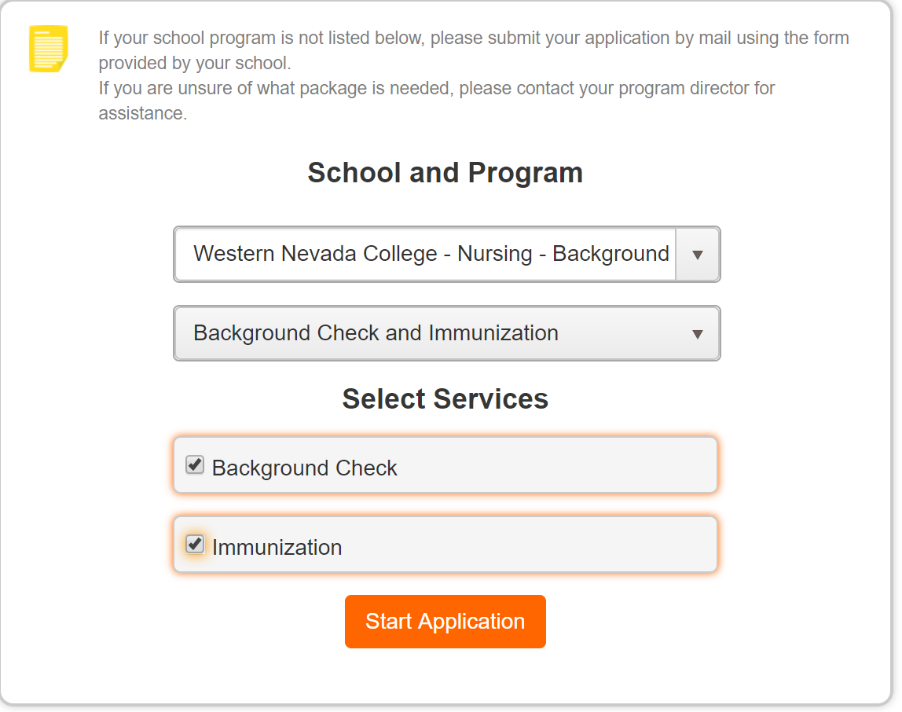

Slide 4
WNC Registration
Press Start Application and then register if you are a new user to PreCheck.
If you are an existing user, just sign in to your existing account.
Once signed in and registered, you will sign several disclosure pages and fill out your information.

Slide 5
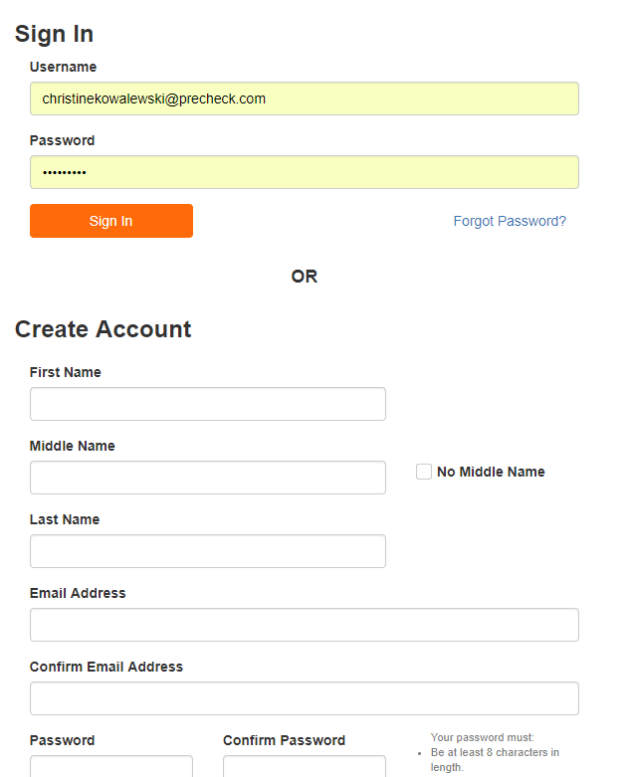

Slide 6
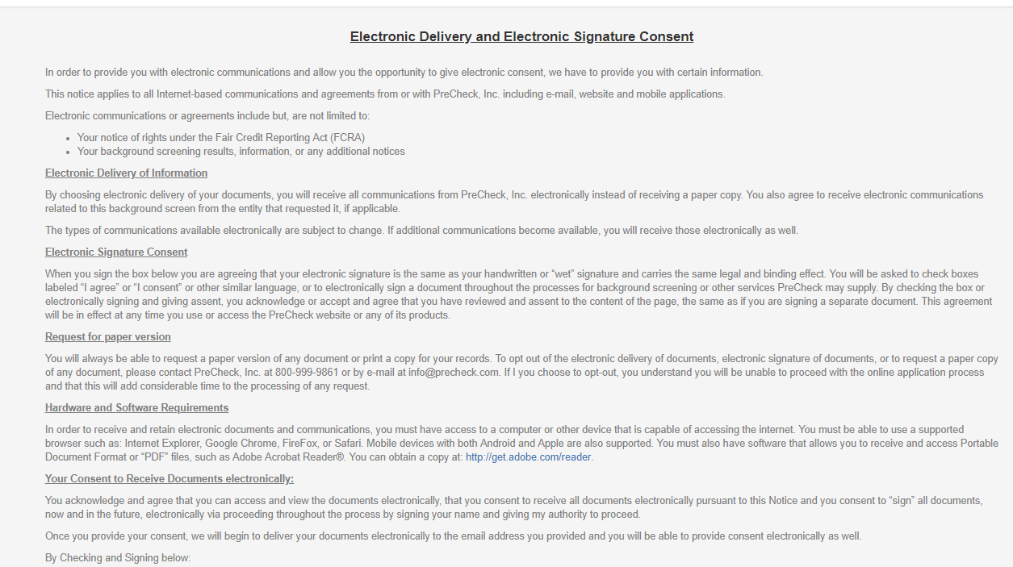

Slide 8
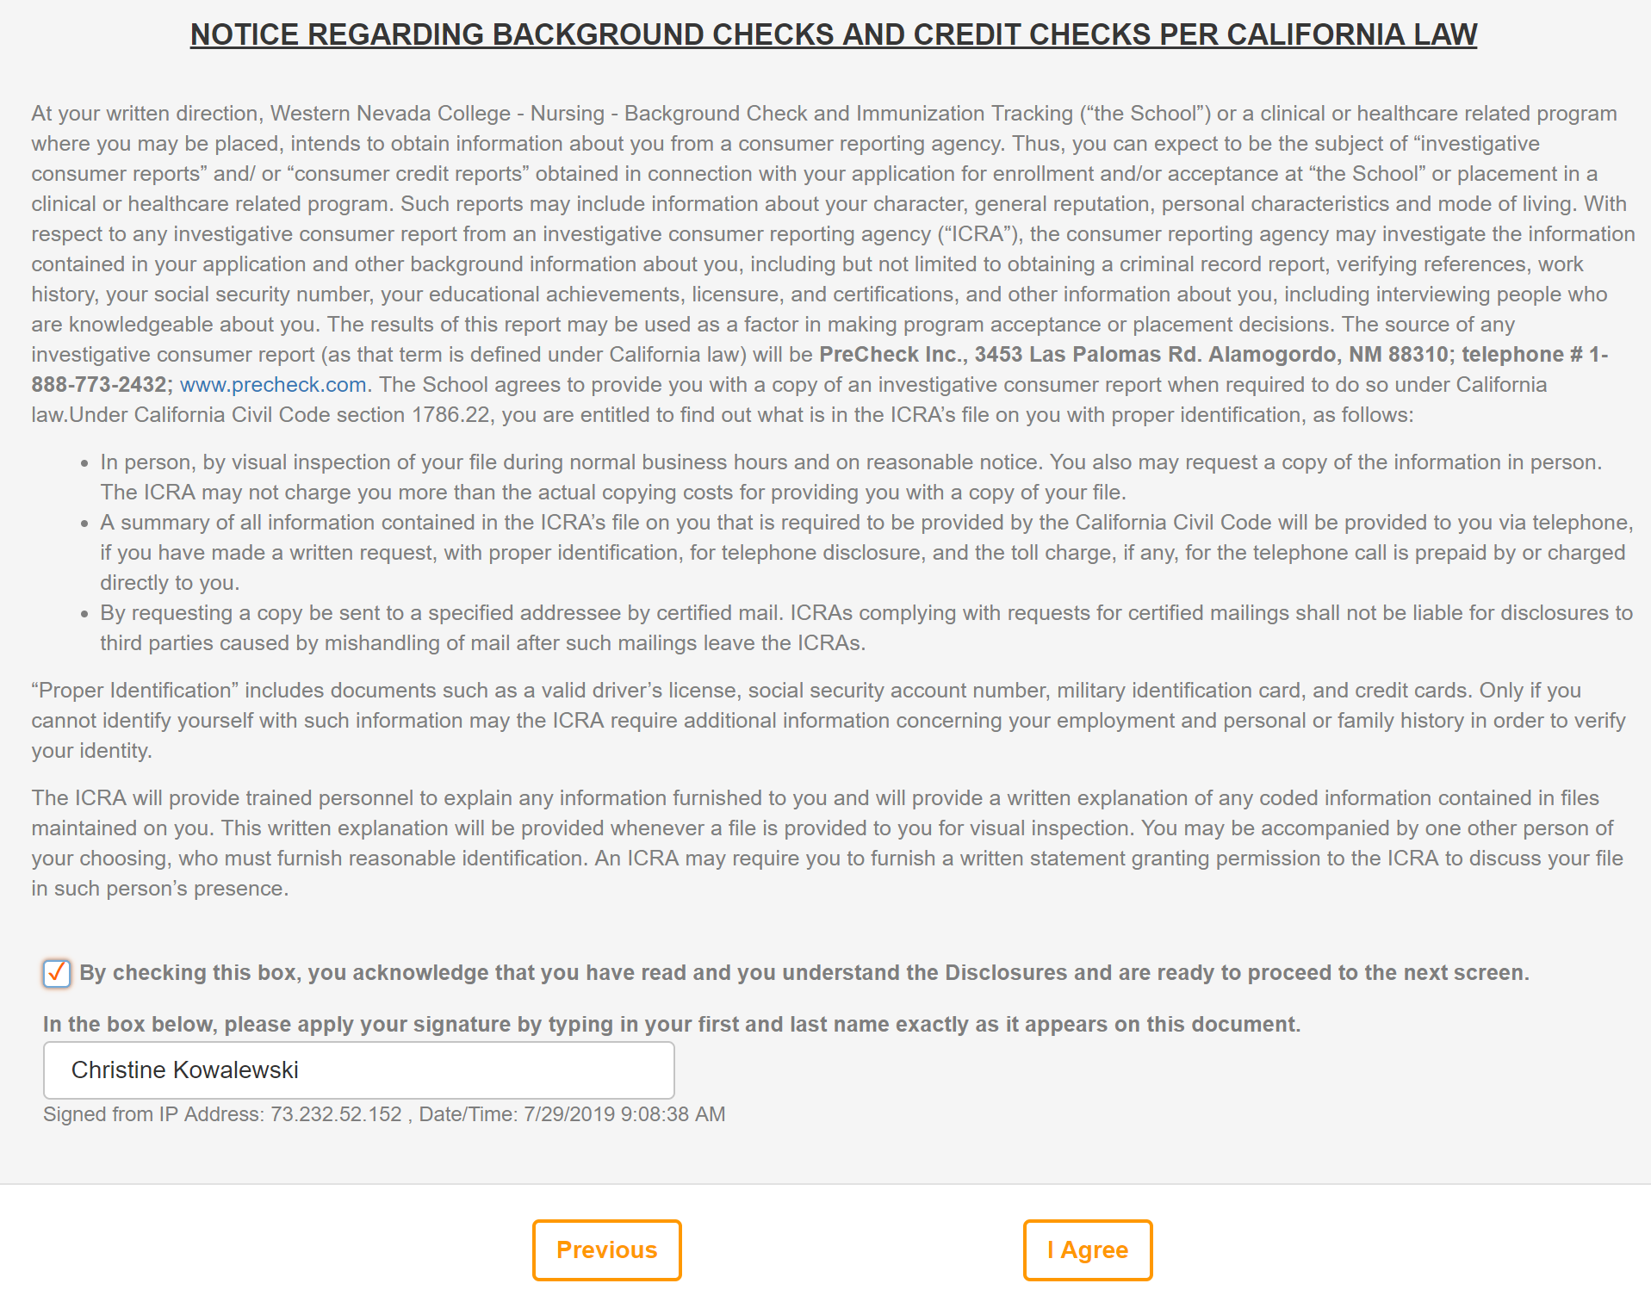

Slide 9
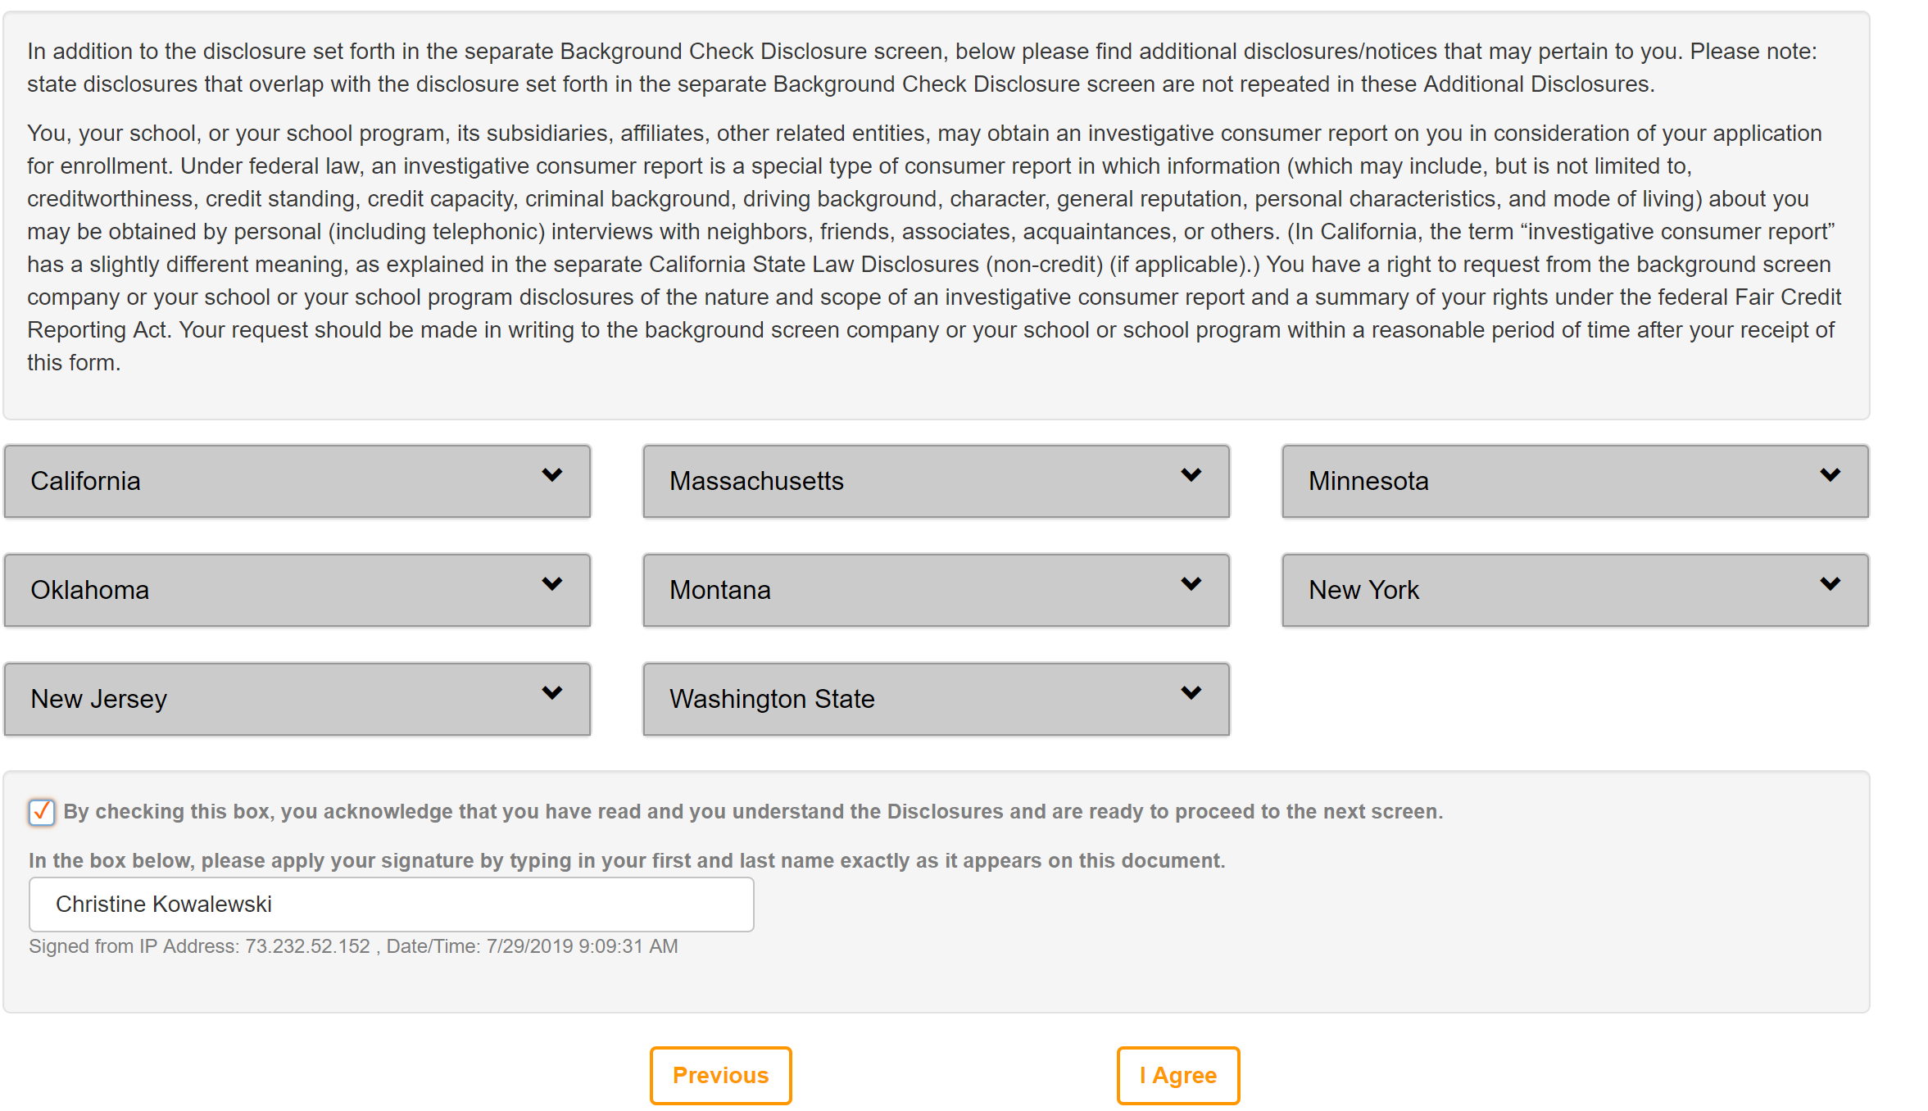

Slide 10
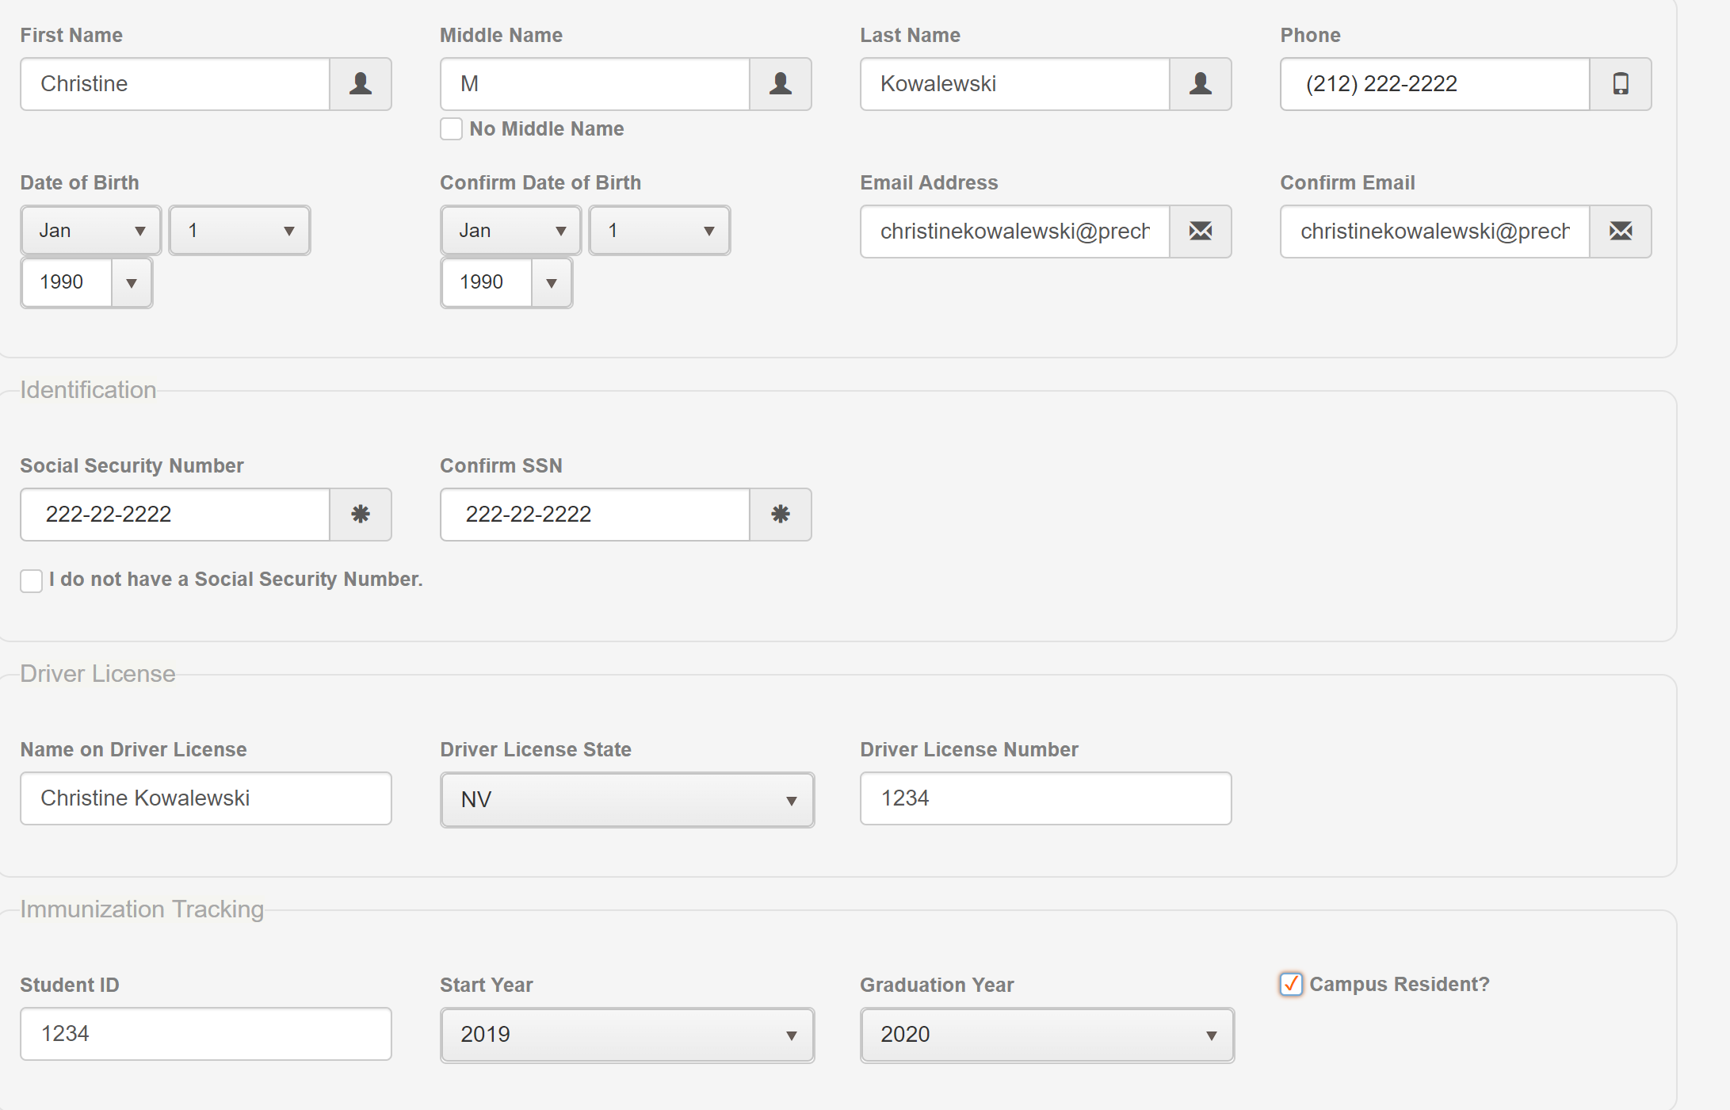

Slide 12
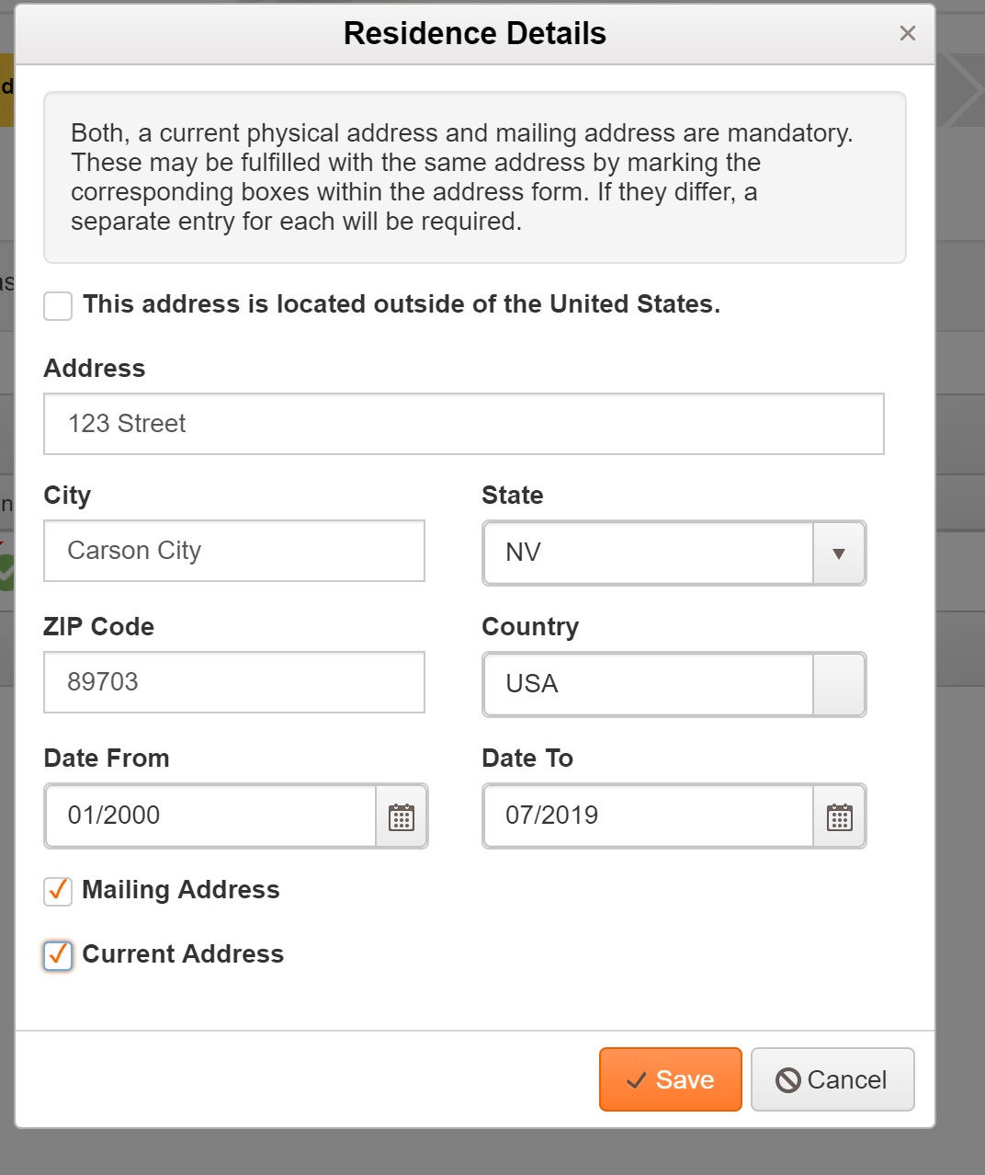

Slide 14
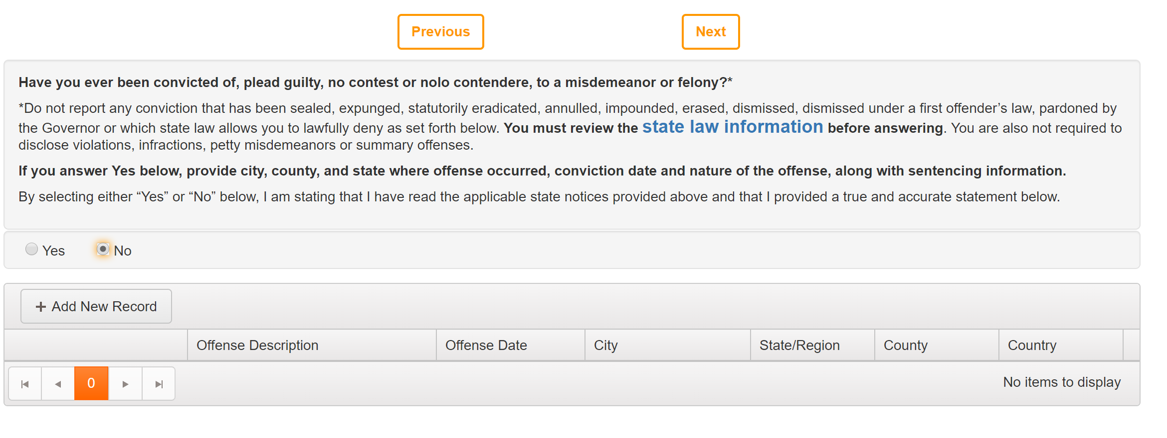

Slide 16
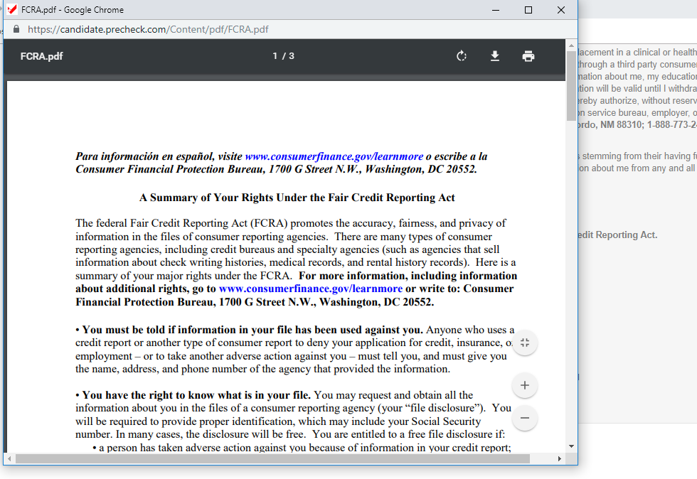
Copy of the FCRA

Slide 17
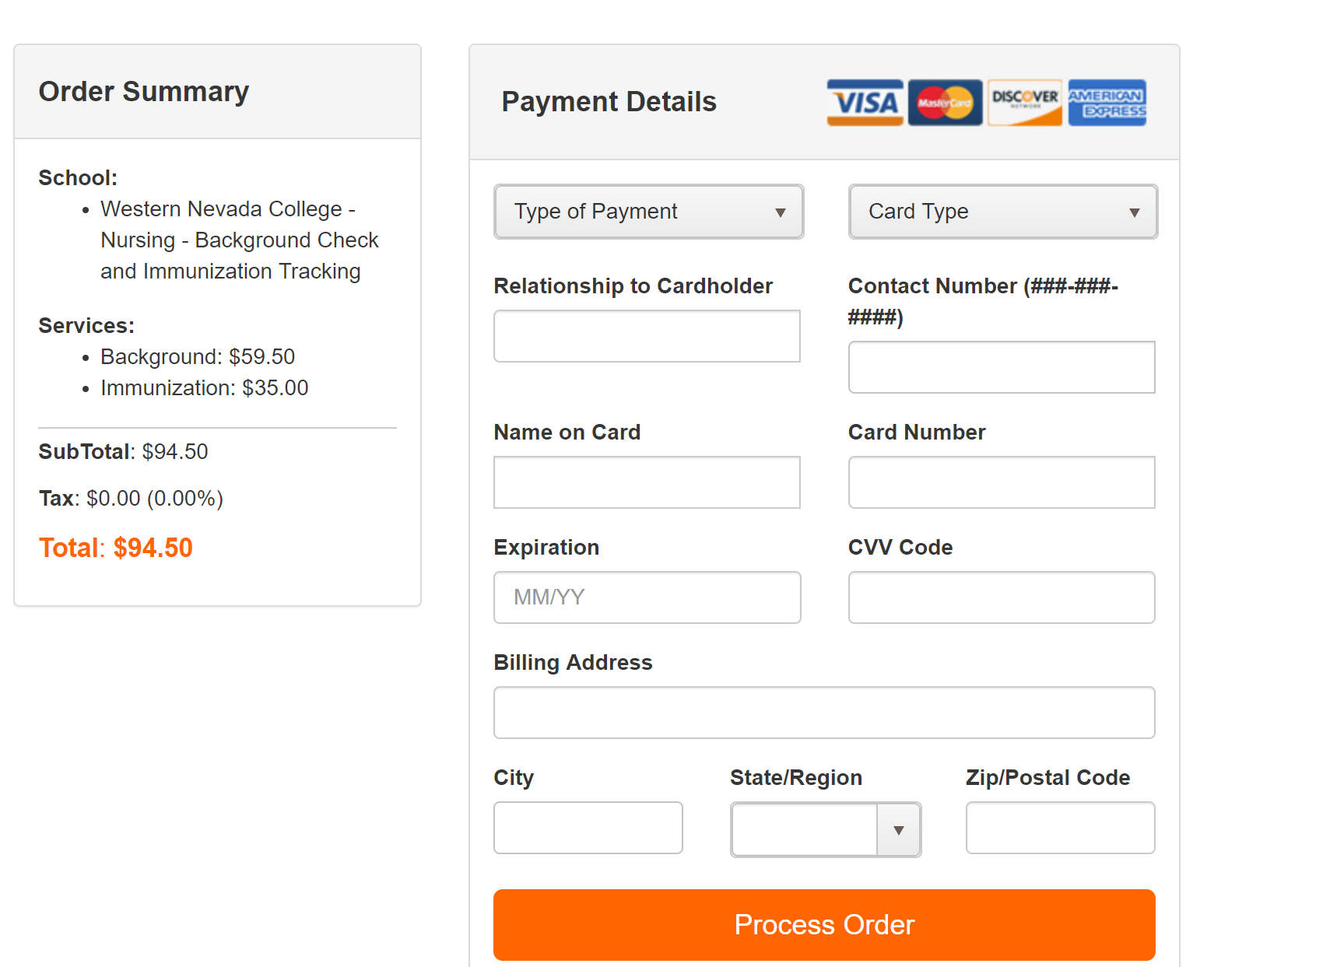

Slide 18
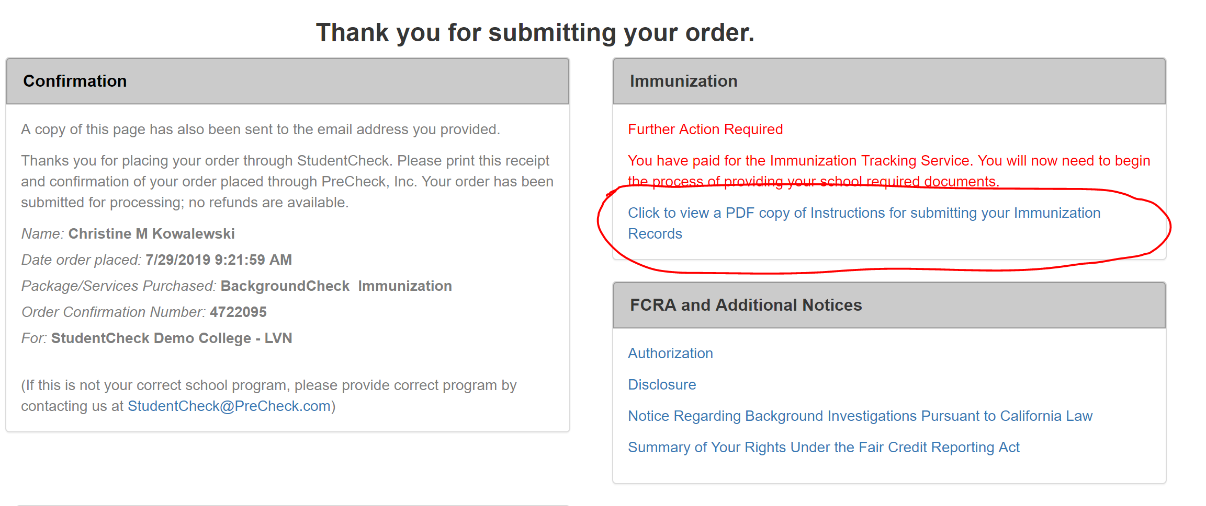
Click on immunization link below

Slide 19
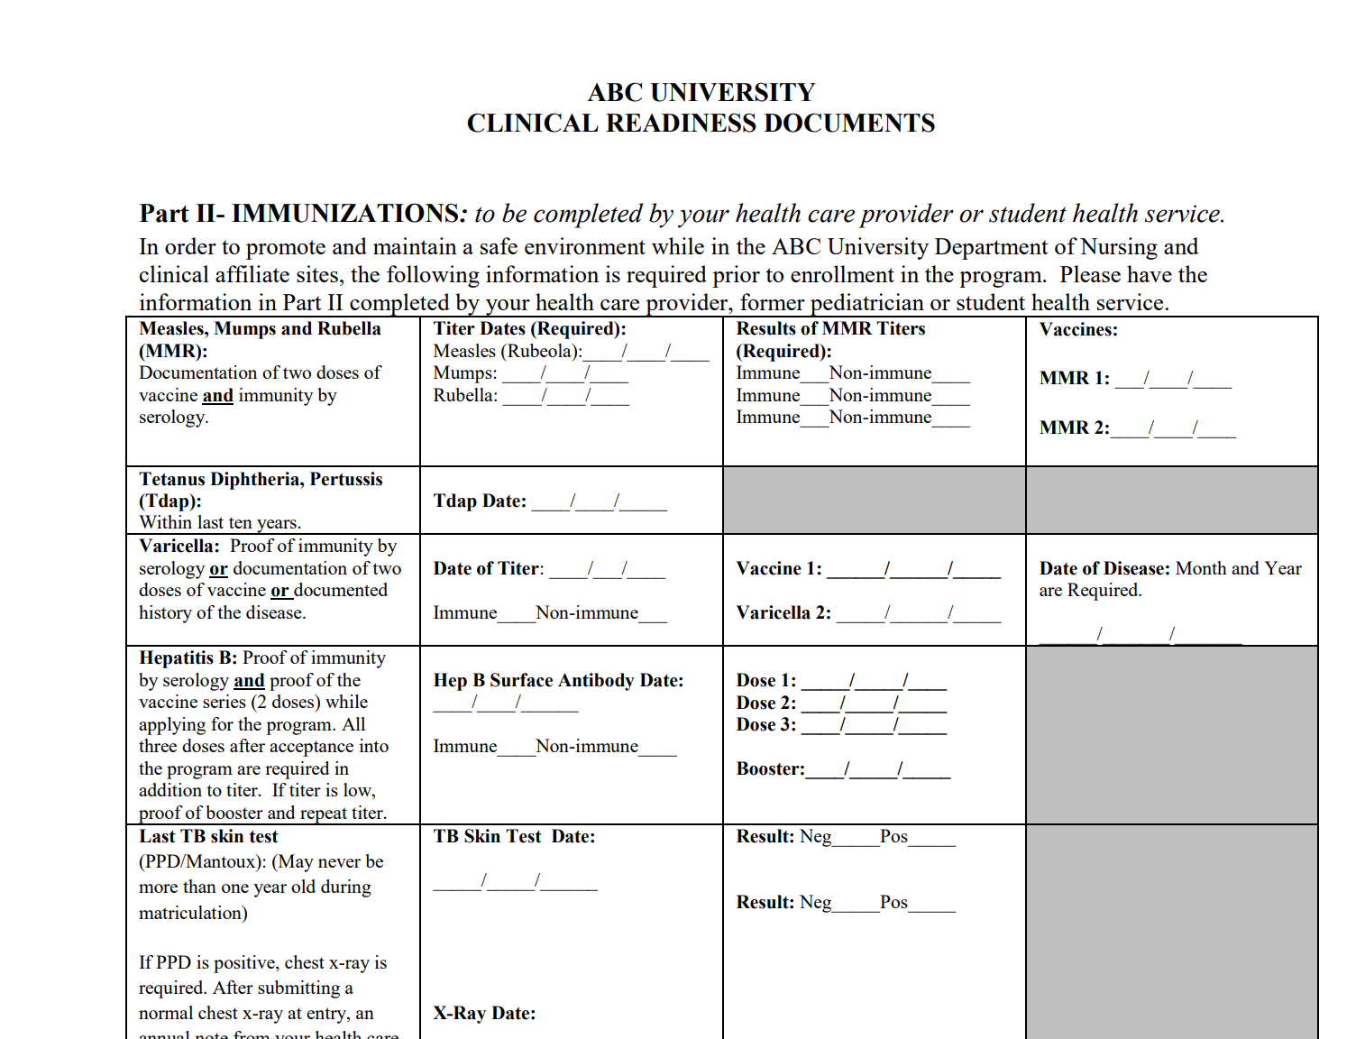
When you click on the immunization link, a copy of your school health forms will populate. The copy here is just a demo form.

